Slide 1
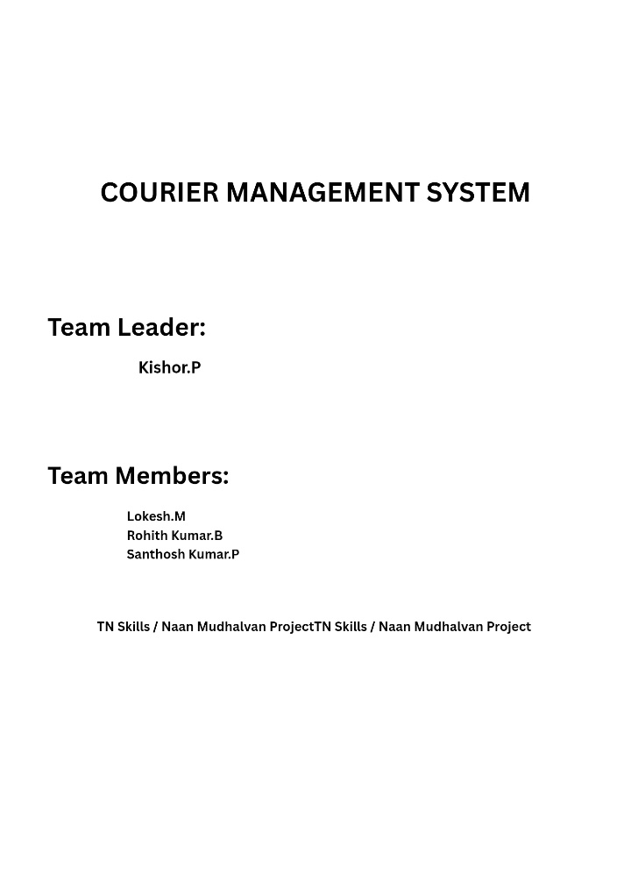

Slide 2
Courier Management System (CMS)
User Story:
Courier and logistics companies often struggle to efficiently manage shipments and deliveries due to reliance on manual processes and disconnected systems. The absence of a centralized shipment tracking mechanism makes it difficult to monitor parcel movement in real time, resulting in delayed delivery updates and poor visibility for customers. Delivery agent assignments are performed manually, increasing the chances of scheduling conflicts and operational delays. Furthermore, the lack of automated notifications prevents timely communication with customers, while the absence of performance analytics limits managerial insight into operational efficiency. Managing multiple branches becomes complex without an integrated platform, leading to coordination issues across locations. Collectively, these challenges result in customer dissatisfaction, reduced productivity, operational inefficiencies, and ultimately revenue loss for the organization.
INTRODUCTION
  Project Overview :
Courier and logistics companies face challenges in efficiently managing shipments and deliveries due to manual operations and disconnected systems. These issues lead to delayed updates, poor customer visibility, and operational inefficiencies.
The Courier Management System (CMS) is a Salesforce-based cloud solution that centralizes shipment booking, tracking, delivery agent assignment, automated status updates, billing, and analytics. The system improves operational efficiency, enhances customer satisfaction, and provides real-time business insights.

Slide 3
1.2 Purpose :
The purpose of the Courier Management System (CMS) is to automate and centralize courier and logistics operations using the Salesforce platform. The system aims to replace manual and fragmented processes with an integrated digital solution that enables efficient shipment booking, real-time tracking, delivery agent assignment, automated notifications, billing, and performance reporting. By providing a single, unified platform for managing shipments across multiple branches, CMS improves operational visibility, enhances customer communication, reduces delays and errors, and supports faster decision-making through analytics. Ultimately, the system is designed to increase service efficiency, customer satisfaction, and overall business profitability.
IDEATION PHASE
  Problem Statement (Customer Problem Statement Template)
PS | I am (Customer) | I’m trying to | But | Because | Which makes me feel
PS-1 | Branch Manager | manage shipments efficiently | tracking is manual | systems are disconnecte d | stressed
PS-2 | Customer | track parcels | updates are delayed | no centralized system | uncertain

Slide 4
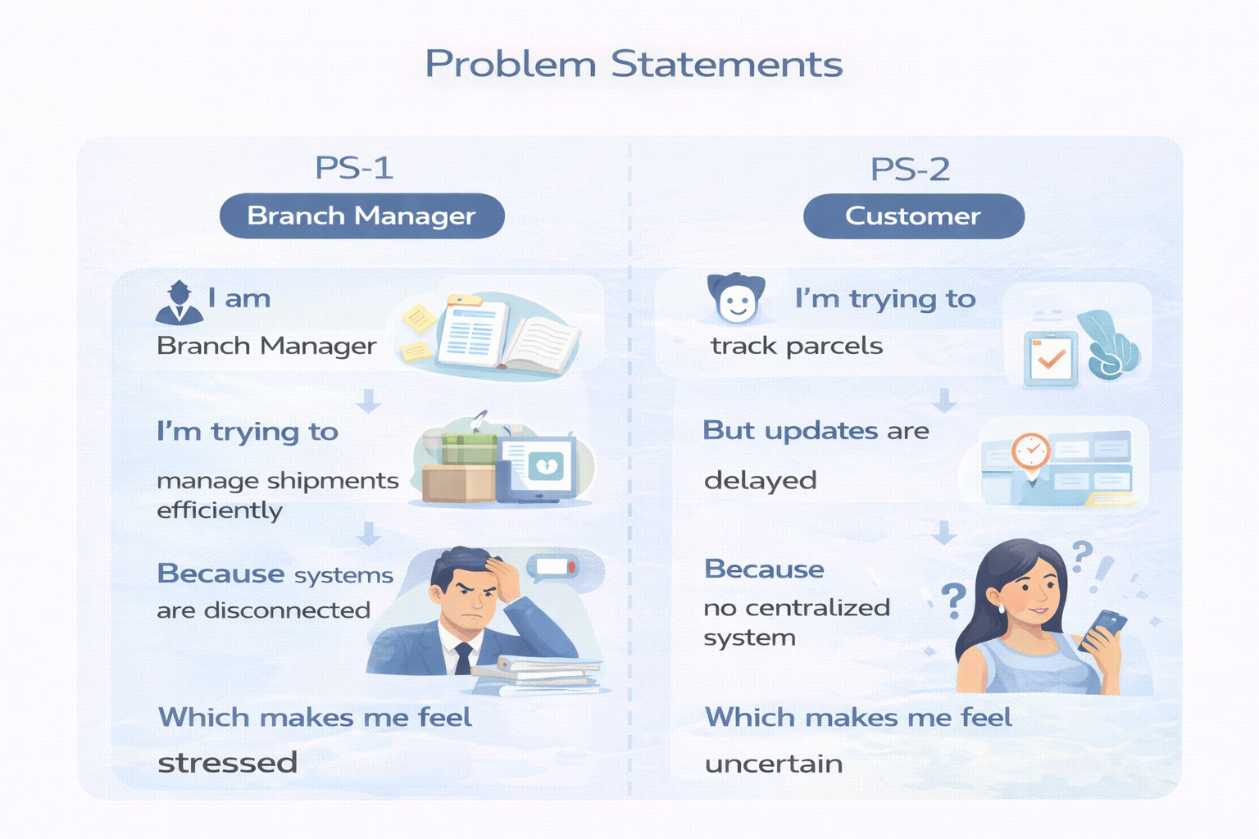
2.2 Empathy Map Canvas
User Persona: Branch Manager
Think & Feel: Concerned about delays & errors
Hear: Customer complaints
See: Registers & spreadsheets
Say & Do: Manual follow-ups
Pain: Delivery conflicts & missed updates
Gain: Automated tracking & dashboards

Slide 5
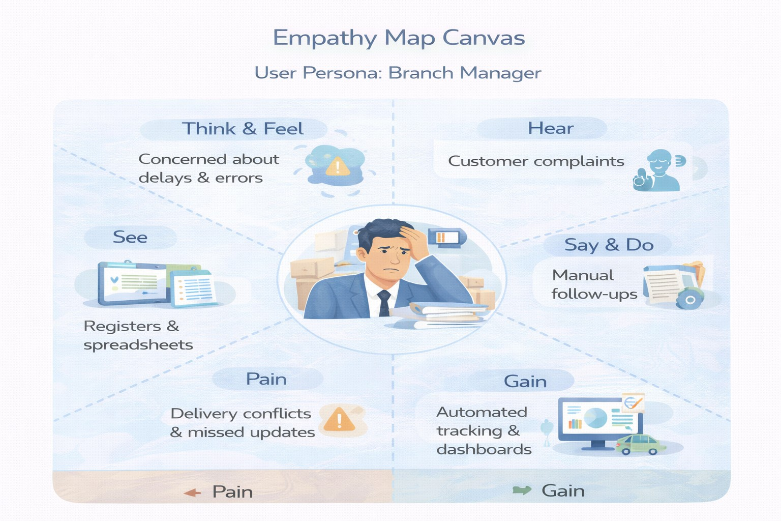
2.3 Brainstorming & Idea Prioritization
Ideas Considered
Manual registers
Spreadsheet tracking
Standalone portal
Salesforce CRM
Final Selection
Salesforce CRM selected due to:
Automation
Scalability
Real-time visibility

Slide 6
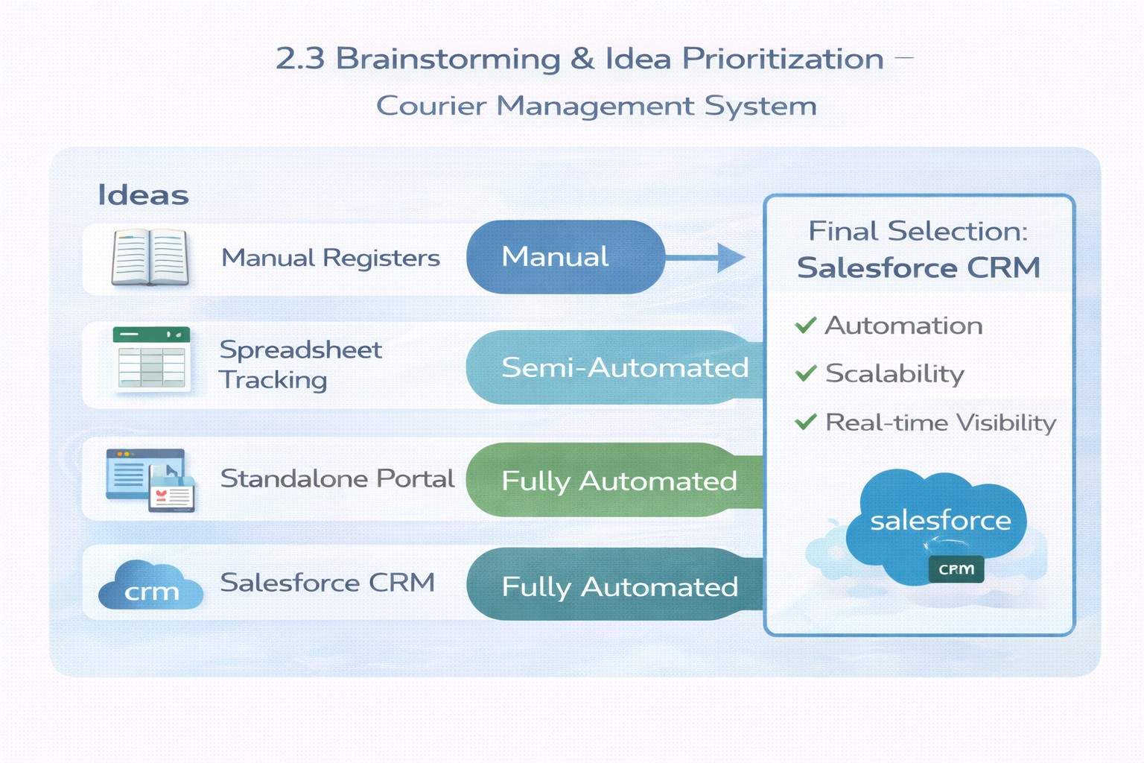
REQUIREMENT ANALYSIS PHASE
  Customer Journey Map
Stages:
    Booking → Shipment Creation → Agent Assignment → Transit → Delivery Update → Invoice → Reporting

Slide 7
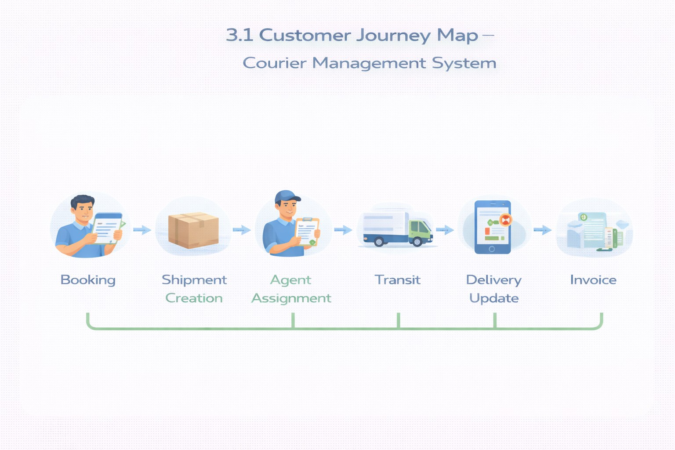
3.2 Solution Requirements
Functional Requirements
FR No | Requirement
FR-1 | Customer management
FR-2 | Shipment booking
FR-3 | Delivery agent assignment
FR-4 | Real-time status updates
FR-5 | Invoice generation

Slide 8
FR-6 | Reports & dashboards
Non-Functional Requirements
NFR | Description
Usability | Easy Lightning interface
Security | Role-based access control
Reliability | Error-free automation
Performance | Fast tracking updates
Availability | 24/7 cloud access
Scalability | Supports growing branches
3.3 Data Flow Diagram
Flow:
Customer Input → Shipment Creation → Validation → Agent Assignment → Delivery Update → Invoice → Reports

Slide 9
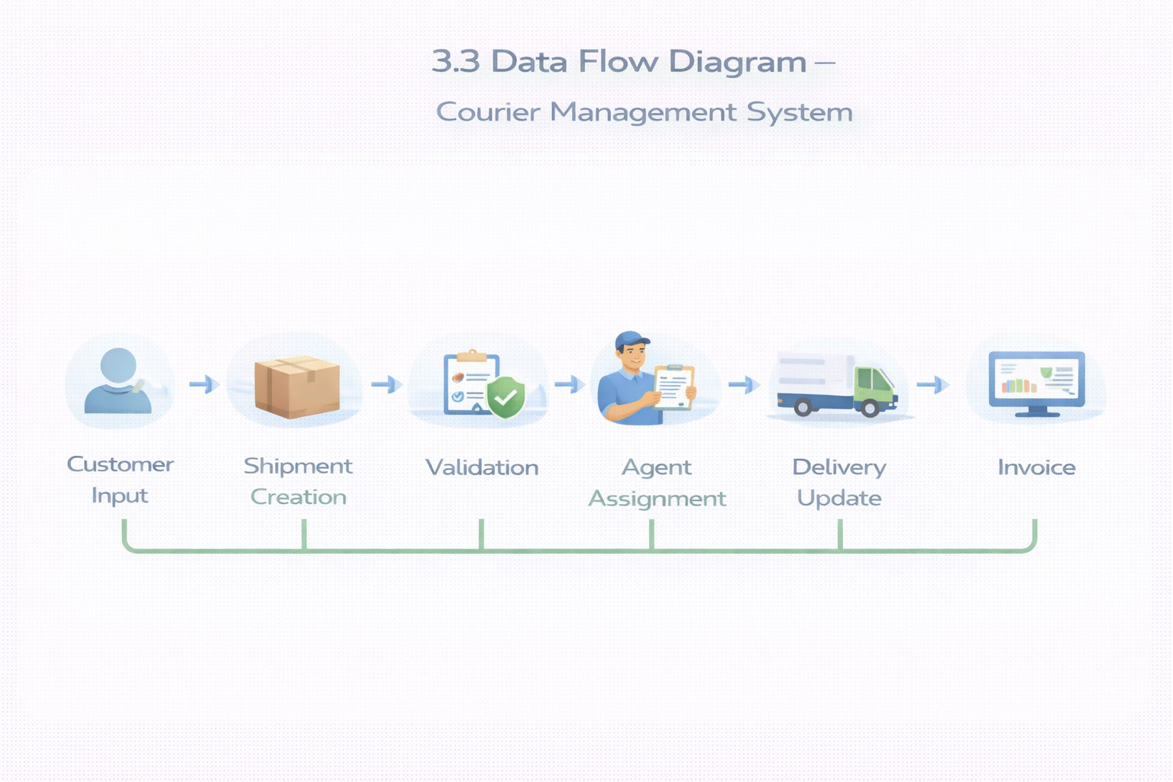
3.4 Technology Stack
Layer | Technology
UI | Salesforce Lightning
Logic | Salesforce Flows
Database | Salesforce Objects
Automation | Validation Rules, Flows
Security | Profiles, Roles
Reporting | Reports & Dashboards

Slide 10
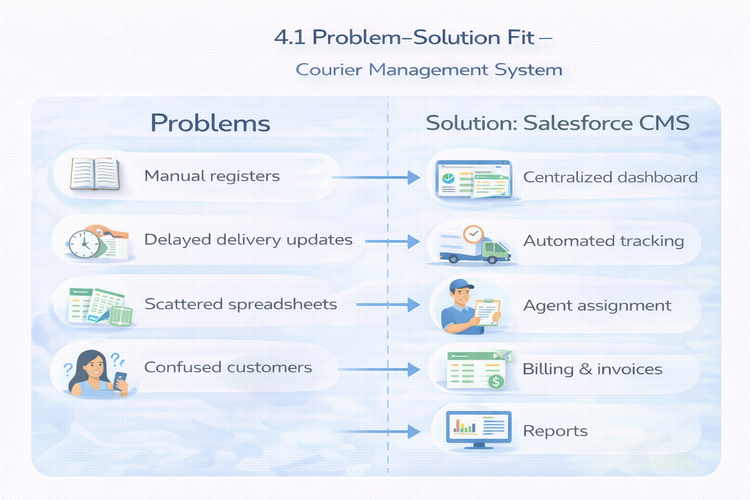
PROJECT DESIGN PHASE
  Problem–Solution Fit
CMS eliminates fragmented courier operations by automating shipment tracking, delivery assignment, billing, and reporting within a centralized Salesforce platform.
4.2 Proposed Solution
Functional Requirements

Slide 11
Parameter | Description
Problem | Manual shipment management
Solution | Salesforce CMS
Innovation | Automated tracking & billing
Impact | Faster deliveries
Business Model | Courier services
Scalability | Multi-branch ready
  Solution Architecture
Components:
    Customer Object
    Shipment Object
    Delivery Agent Object
    Branch Object
    Delivery Update Object
    Invoice Object
    Flows
    Reports
    Dashboards

Slide 12
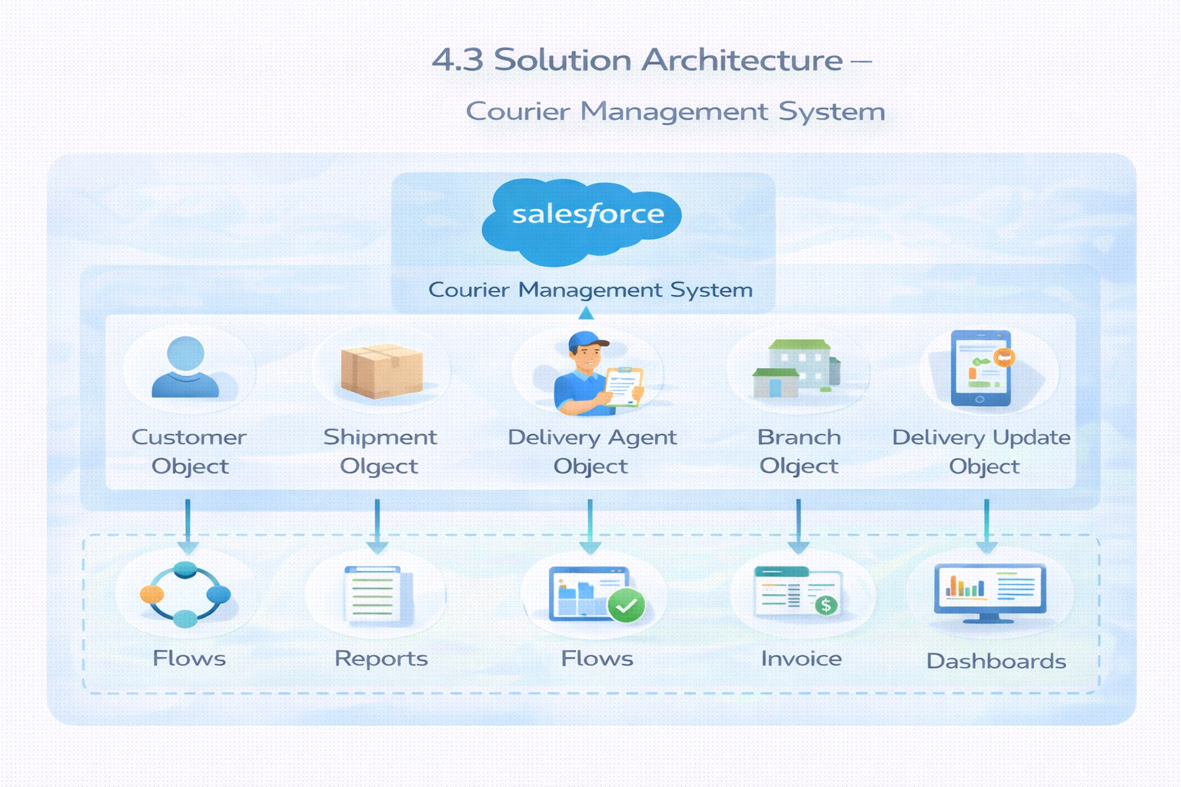
PROJECT PLANNING & SCHEDULING
  Project Planning
    Agile methodology
    Epics → Stories → Story Points
    Sprint-based execution
    Velocity calculation used for estimation
Product Backlog, Sprint Schedule, and Estimation (4 Marks)
Use the below template to create product backlog and sprint schedule
Sprint | Functional Requirement (Epic) | User Story Number | User Story / Task | Story Points | Priority | Team Member s
Sprint-1 | Developer Setup | USN-1 | As a system administrator, I want to create and configure a Salesforce developer account so that I can set up and deploy the Courier Management System. | 3 | High | Member1
Sprint-2 | Data Modeling | USN-2 | As an admin, I want to create Customer, Shipment, Delivery | 5 | High | Member2

Slide 13
Sprint | Functional Requirement (Epic) | User Story Number | User Story / Task | Story Points | Priority | Team Member s
 |  |  | Agent, Branch, and Invoice objects with proper relationships so that courier data is stored and managed efficiently.
Sprint-2 | Data Modeling | USN-3 | As a staff member, I want tabs and a Lightning App for all courier modules so that I can easily navigate and perform daily operations. | 5 | High | Member3
Sprint-3 | Automation | USN-4 | As a system, I want to validate shipment details such as delivery dates, addresses, and mandatory fields so that incorrect or incomplete records are prevented. | 3 | High | Member4
Sprint-3 | Automation | USN-5 | As a dispatcher, I want automated flows for shipment status updates and agent assignment so that deliveries are processed faster without manual intervention. | 3 | High | Member4
Sprint-4 | Security | USN-6 | As an administrator, I want role-based access control for managers, agents, and staff so that sensitive shipment and billing data is secure. | 5 | High | Member2
Sprint-5 | Reports | USN-7 | As a branch manager, I want reports showing delivery performance, shipment status, and revenue so that I can monitor operations and make informed decisions. | 4 | High | Member3
Sprint-6 | Dashboards | USN-8 | As a branch manager, I want dashboards showing delivery performance, shipment status, and revenue so that I can monitor operations and make informed decisions. | 4 | Medium | Member4
Project Tracker, Velocity & Burndown Chart: (4 Marks)
Sprint | Total Story Points | Duratio n | Sprint Start Date | Sprint End Date (Planned) | Story Points Completed (as on Planned End Date) | Sprint Release Date (Actual)
Sprint-1 | 20 | 6 Days | 24 Oct 2022 | 29 Oct 2022 | 20 | 29 Oct 2022

Slide 14
Sprint | Total Story Points | Duratio n | Sprint Start Date | Sprint End Date (Planned) | Story Points Completed (as on Planned End Date) | Sprint Release Date (Actual)
Sprint-2 | 20 | 6 Days | 31 Oct 2022 | 05 Nov 2022
Sprint-3 | 20 | 6 Days | 07 Nov 2022 | 12 Nov 2022
Sprint-4 | 20 | 6 Days | 14 Nov 2022 | 19 Nov 2022
6. Project Development Phase:
What you'll learn
Real-time Salesforce project implementation
Designing custom objects and relationships
Creating page layouts & record types
Writing validation rules
Building automation with flows
Developing reports & dashboards
Setting up security with profiles, permission sets, and sharing
End-to-end application testing
Milestone 1: Salesforce Account
Introduction:
New to Salesforce and unsure where to start? Curious how real business applications—like loan processing and payment tracking—can be built on the platform? You’re in the right place.

Slide 15
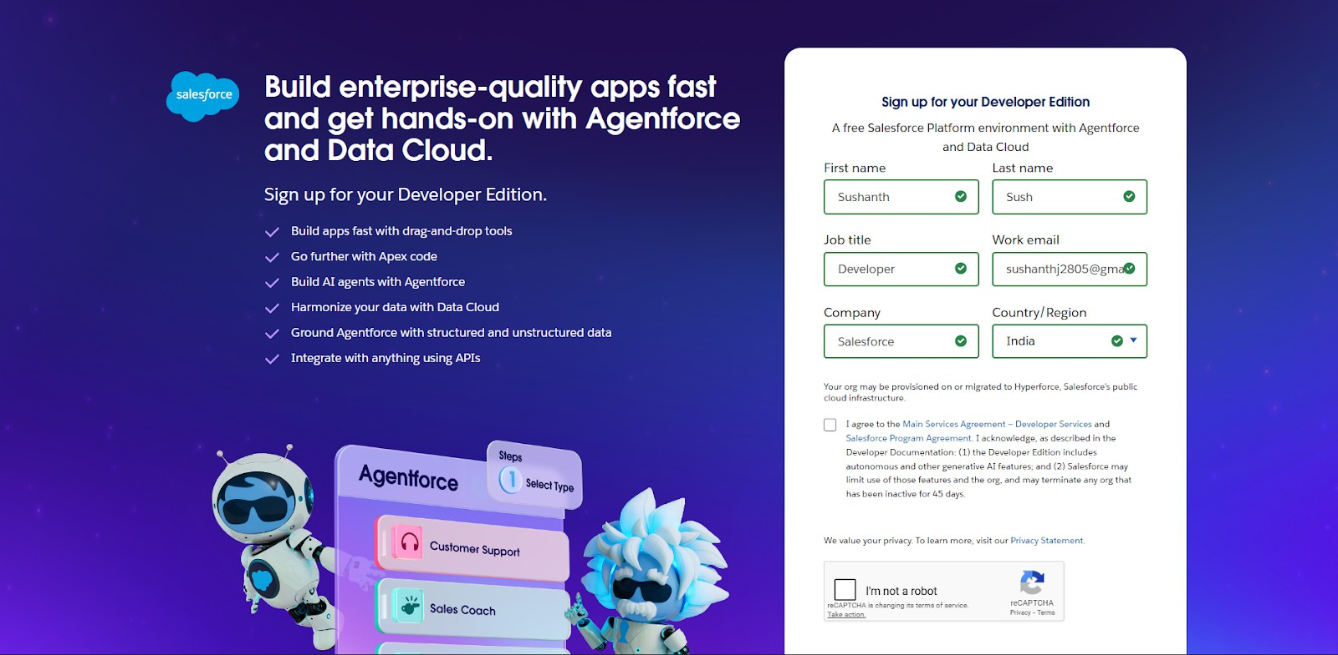
Welcome to the Loan Management System project!
Salesforce offers powerful tools that help automate processes, improve accuracy, and manage customer operations with ease. In this project, you’ll learn how Salesforce can streamline lending workflows—from borrower onboarding to loan approval, EMI tracking, and document verification.
What Is Salesforce ?
Salesforce is your customer success platform, designed to help you sell, service, market, analyze, and connect with your customers. Salesforce has everything you need to run your business from anywhere. Using standard products and features, you can manage relationships with prospects and customers, collaborate and engage with employees and partners, and store your data securely in the cloud.
Activity 1: Creating Developer Account
Creating a developer org in salesforce.
Go to https://developer.salesforce.com/signup
On the sign up form, enter the following details :
First name & Last name
Email
First name & Last name
Email

Slide 16
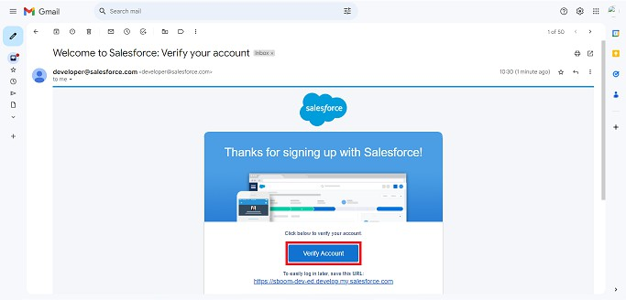
Job Title: Developer
Company: College Name
Country: India
Click on sign me up after filling these.
Activity 2: Account Activation
1. Go to the inbox of the email that you used while signing up. Click on the verify account to activate your account. The email may take 10-30 mins and sometimes 2 hours.
Click on Verify Account
Give a password and answer a security question and click on change password.
Then you will redirect to your salesforce setup page.

Slide 17
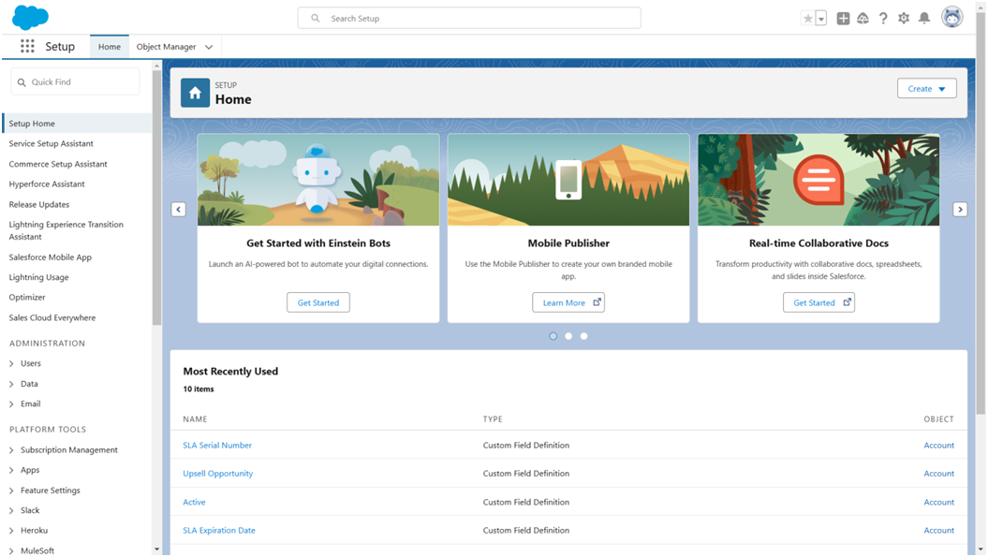
Milestone 2- Object:
What is an object?
Salesforce objects are database tables that permit you to store data that is specific to an
organization. It consists of fields (columns) and records (rows).
Custom Objects Created:
Customer c – stores customer personal and contact information
Shipment c – manages parcel details, source, destination, and tracking information
Delivery_Agent c – maintains delivery agent profiles and branch details
Branch c – represents courier branch offices

Slide 18
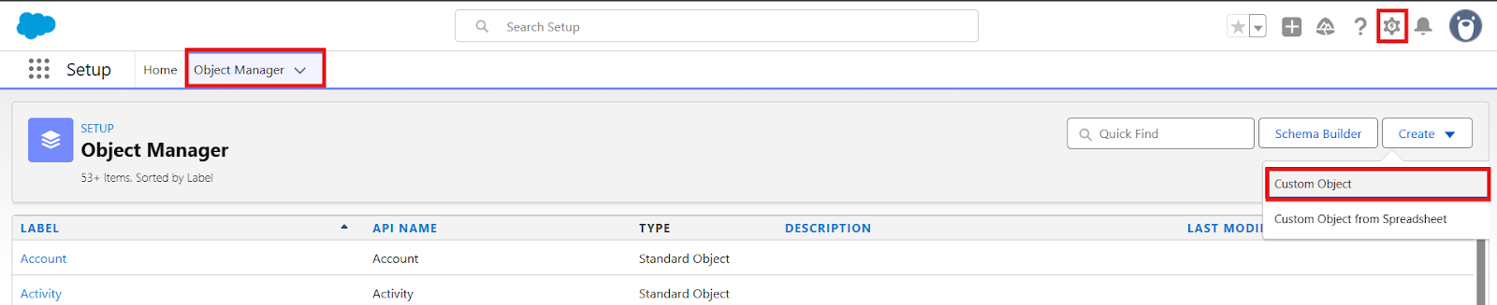
Delivery_Update c – stores status updates for each shipment
Invoice c – manages billing details for delivered shipments
Relationships:
Customer → Shipment (Lookup) Shipment → Delivery_Agent (Lookup) Delivery_Agent → Branch (Lookup)
Delivery_Update → Shipment (Master-Detail) Invoice → Shipment (Lookup)
Steps to Implement :
Activity 1: Create Customer Object
  Click Setup → Object Manager → Create → Custom Object
Enter the following details:
  Label: Customer
  Plural Label: Customers
  Record Name: Customer Name (Text)
3. Under Optional Features:

Slide 19
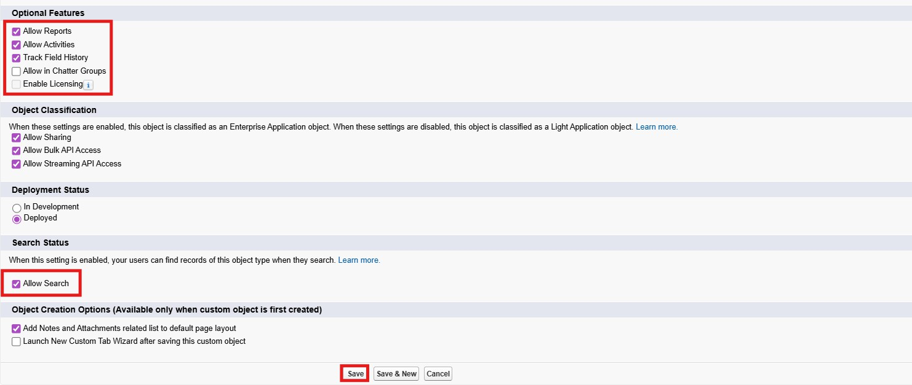
Enable Allow Reports
Enable Track Field History
In Search Status check the box Allow Search
In Object Creation Options check the box Add Notes and Attachments related list to default page layout
4. Click Save.
Activity 2: Create Shipment Object
Go to Setup → Object Manager → Create → Custom Object
Enter:
  Label: Shipment
  Plural Label: Shipments
  Record Name: Tracking Number (Auto Number)
Example Format: SHP-{00000} Starting Number: 0
Enable:

Slide 20
Allow Reports
Track Field History
5. Click Save
Activity 3: Create Delivery_Agent Object
Setup → Object Manager → Create → Custom Object
Enter:
  Label: Delivery Agent
  Plural Label: Delivery Agents
  Record Name: Agent Name (Text)
Enable:
  Allow Reports
  Track Field History
4. Click Save
Activity 4: Create Branch Object
Setup → Object Manager → Create → Custom Object
Enter:
  Label: Branch

Slide 21
Plural Label: Branches
Record Name: Branch Name (Text)
Enable:
  Allow Reports
4. Click Save.
Activity 5: Create Delivery_Update Object
Setup → Object Manager → Create → Custom Object
Enter:
  Label: Delivery Update
  Plural Label: Delivery Updates
  Record Name: Update Number (Auto Number)
Example Format: UPD-{0000} Enter Starting number : 0
Enable:
  Allow Reports
  Track Field History
5. Click Save.

Slide 22
Activity 6: Create Invoice Object
Setup → Object Manager → Create → Custom Object
Enter:
  Label: Invoice
  Plural Label: Invoices
  Record Name: Invoice Number (Auto Number)
Example Format: INV-{0000} Enter Starting number: 0
Enable:
  Allow Reports
  Track Field History
5. Click Save
Milestone 3 - Tabs
Tab:
Tabs in Salesforce help users view the information at a glance. It displays the data of objects and other web content in the application.
Activity 1: Creating a Tab for Customer Object
Click Home, type Tabs in Quick Find, and select Tabs.
Under Custom Object Tabs, click New.

Slide 23
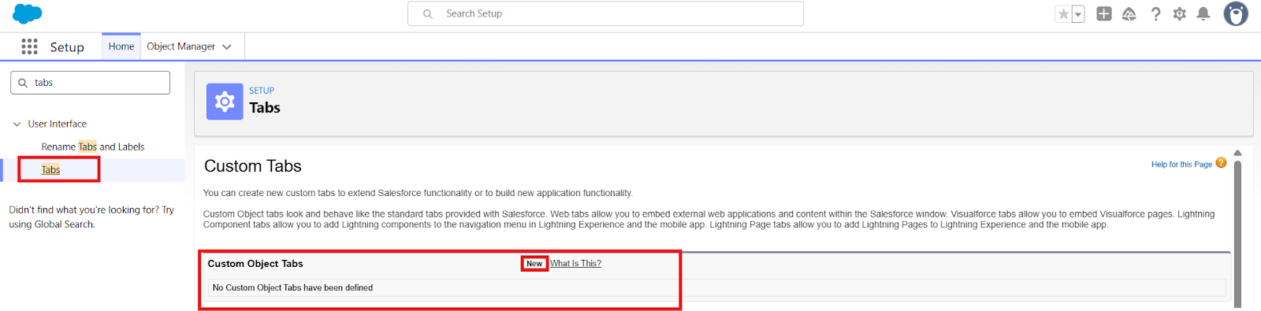
For Object, select Customer.
For Tab Style, choose any icon.
Leave all default settings as they are.
Click Next, Next, and Save.
Activity 2: Creating a Tab for Shipment Object
Click Home, type Tabs in Quick Find, and select Tabs.
Under Custom Object Tabs, click New.
For Object, select Shipment.
Choose any Tab Style.
Keep defaults unchanged.
Click Next, Next, and Save.
Activity 3: Creating a Tab for Delivery Agent Object
Click Home, type Tabs in Quick Find, and select Tabs.
Under Custom Object Tabs, click New.
For Object, select Delivery Agent.

Slide 24
Pick any Tab Style.
Leave default settings.
Click Next, Next, and Save.
Activity 4: Creating a Tab for Branch Object
Click Home, type Tabs in Quick Find, and select Tabs.
Under Custom Object Tabs, click New.
For Object, select Branch.
Choose any Tab Style.
Keep all defaults.
Click Next, Next, and Save.
Activity 5: Creating a Tab for Delivery Update Object
Click Home, type Tabs in Quick Find, and select Tabs.
Under Custom Object Tabs, click New.
For Object, select Delivery Update.
Select any Tab Style.
Keep default configurations.
Click Next, Next, and Save.

Slide 25
Activity 6: Creating a Tab for Invoice Object
Click Home, type Tabs in Quick Find, and select Tabs.
Under Custom Object Tabs, click New.
For Object, select Invoice.
Select any Tab Style.
Leave defaults unchanged.
Click Next, Next, and Save.
Milestone 4: Fields & Relationships
What are fields ?
Fields in Salesforce represent what the columns represent in relational databases. It can store data values which are required for a particular object in a record.
Activity 1: Creation of fields for the Customer Object
Field Name | API Name | Data Type | Required | Description
Customer Name | Name | Text | Yes | Full name of customer
Email | Email c | Email | Yes | Customer email
Phone | Phone c | Phone | Yes | Customer contact number
Address | Address c | Text Area | Yes | Customer address

Slide 26
Customer Type | Customer_Type c | Picklist | Yes | Regular / Business
City | City c | Text | No | Customer city
State | State c | Text | No | Customer state
Pincode | Pincode c | Text | No | Postal code
Is Active | Is_Active c | Checkbox | No | Active status
Email (Email Field)
  Go to Setup → Object Manager → Customer c
  Click Fields & Relationships → New
  Select Email → Next
  Field Label: Email
  Check the Required box
  Click Next → Next → Save
Phone (Phone Field)
  Setup → Object Manager → Customer c
  Fields & Relationships → New
  Select Phone → Next
  Field Label: Phone
  Check Required
  Click Next → Next → Save
Address (Text Area)
  Setup → Object Manager → Customer c

Slide 27
Fields & Relationships → New
Select Textarea → Next
Field Label: Address
Check Required
Save
Customer Type (Picklist)
  Setup → Customer c → Fields → New
  Picklist → Next
  Field Label: Customer Type
  Enter values:
    Regular
    Business
  Check Required
  Save
City (Text)
  Setup → Customer c → Fields → New
  Text → Next
  Field Label: City
  Save
State (Text)

Slide 28
Setup → Customer c → Fields → New
Text → Next
Field Label: State
Save
Pincode (Text)
  Setup → Customer c → Fields → New
  Text → Next
  Field Label: Pincode
  Save
Is Active (Checkbox)
  Setup → Customer c → Fields → New
  Checkbox → Next
  Field Label: Is Active
  Save
Activity 2: Creation of fields for the Shipment Object
Field Name | API Name | Data Type | Required | Description
Tracking Number | Name | Auto Number | Yes | Unique ID

Slide 29
Customer | Customer c | Lookup(Customer) | Yes | Related customer
Source Address | Source_Address c | Text Area | Yes | Pickup location
Destination Address | Destination_Address_ _c | Text Area | Yes | Delivery location
Weight | Weight c | Number | Yes | Parcel weight
Price | Price c | Currency | Yes | Shipping charge
Status | Status c | Picklist | Yes | Shipment status
Expected Date | Expected_Date c | Date | Yes | Delivery estimate
Assigned Agent | Assigned_Agent c | Lookup(Delivery_Age nt) | No | Delivery agent
Shipment Type | Shipment_Type c | Picklist | Yes | Domestic/International
Source Address (Text Area)
  Setup → Shipment c → Fields → New
  Textarea → Next
  Field Label: Source Address
  Required → Save
Destination Address (Text Area)
  Setup → Shipment c → Fields → New
  Textarea → Next

Slide 30
Field Label: Destination Address
Required → Save
Weight (Number)
  Setup → Shipment c → Fields → New
  Number → Next
  Field Label: Weight
  Required → Save
Price (Currency)
  Setup → Shipment c → Fields → New
  Currency → Next
  Field Label: Price
  Required → Save
Status (Picklist)
Values:
  Booked
  In Transit
  Out for Delivery
  Delivered

Slide 31
Cancelled
Required → Save
Expected Date (Date)
  Setup → Shipment c → Fields → New
  Date → Next
  Field Label: Expected Date
  Required → Save
Shipment Type (Picklist)
Values:
  Domestic
  International
Required → Save
Activity 3: Creation of fields for Delivery_Agent Object
Field Name | API Name | Data Type | Required
Agent Name | Name | Text | Yes
Email | Email c | Email | Yes
Phone | Phone c | Phone | Yes
Branch | Branch c | Lookup | Yes

Slide 32
Status | Status c | Picklist | Yes
Joining Date | Joining_Date c | Date | No
Email
  Setup → Delivery_Agent c → Fields → New
  Email → Next
  Field Label: Email
  Required → Save
Phone
  Setup → Delivery_Agent c → Fields → New
  Phone → Next
  Field Label: Phone
  Required → Save
Status (Picklist)
Values:
  Active
  Inactive
  On Leave
Required → Save
Joining Date

Slide 33
Setup → Delivery_Agent c → Fields → New
Date → Next
Field Label: Joining Date
Save
Activity 4: Creation of fields for Branch Object
Field Name | API Name | Data Type | Required
Branch Name | Name | Text | Yes
Branch Code | Branch_Code c | Text | Yes
City | City c | Text | Yes
State | State c | Text | Yes
Manager Name | Manager_Name c | Text | No
Create each field using:
Setup → Branch c → Fields → New
Select respective Data Type
Enter Field Label
Save
(Repeat for all fields)
Activity 5: Creation of fields for Delivery_Update Object
Field Name | API Name | Data Type | Required

Slide 34
Update Number | Name | Auto Number | Yes
Shipment | Shipment c | Master-Detail | Yes
Status | Status c | Picklist | Yes
Update Date | Update_Date c | DateTime | Yes
Remarks | Remarks c | Text | No
Status Picklist Values:
In Transit
Out for Delivery
Delivered
Delayed
Required → Save
Activity 6: Creation of fields for Invoice Object
Field Name | API Name | Data Type | Required
Invoice Number | Name | Auto Number | Yes
Shipment | Shipment c | Lookup | Yes
Amount | Amount c | Currency | Yes
Invoice Date | Invoice_Date c | Date | Yes
Payment Status | Payment_Status c | Picklist | Yes

Slide 35
Payment Status Values
Paid
Unpaid
Pending
Required → Save
Relationships :
Child Object | Field | Parent Object | Type
Shipment | Customer c | Customer | Lookup
Shipment | Assigned_Agent c | Delivery_Agent | Lookup
Delivery_Agent | Branch c | Branch | Lookup
Delivery_Update | Shipment c | Shipment | Master-Detail
Invoice | Shipment c | Shipment | Lookup
Relationship Creation Steps :
Activity 1 – Shipment → Customer
Setup → Shipment c → Fields → New
Lookup Relationship
Related Object: Customer c
Field Label: Customer
Save

Slide 36
Activity 2 – Shipment → Delivery Agent
Setup → Shipment c
New → Lookup
Object: Delivery_Agent c
Label: Assigned Agent
Save
Activity 3 – Delivery Agent → Branch
Setup → Delivery_Agent c
New → Lookup
Related Object: Branch c
Label: Branch
Save
Activity 4 – Delivery Update → Shipment
Setup → Delivery_Update c
New → Master-Detail
Related Object: Shipment c
Save
Activity 5 – Invoice → Shipment
Setup → Invoice c

Slide 37
New → Lookup
Object: Shipment c
Save
Milestone 5-Validation Rules :
Validation rules are applied when a user tries to save a record and are used to check if the data meets specified criteria. If the criteria are not met, the validation rule triggers an error message and prevents the user from saving the record until the issues are resolved.
Activity 1: Create Validation Rules on Customer c
Validation Rule: Email Must Not Be Blank
Steps:
  Click the Gear icon → Setup
  Go to Object Manager
  Search and select Customer c
  From the left menu, click Validation Rules
  Click New
  Rule Name: Email_Required
  Check Active

Slide 38
In Error Condition Formula, paste:
ISBLANK(Email c)
Click Check Syntax
Error Message: Email is required.
Error Location: Field → Email
Click Save.
Validation Rule: Phone Must Be 10 Digits
Steps:
  Setup → Object Manager → Customer c
  Validation Rules → New
  Rule Name: Validate_Phone_Number
  Check Active
Formula:
LEN(Phone c) <> 10
  Check Syntax
  Error Message: Phone number must be 10 digits.
  Error Location: Field → Phone
  Save
Validation Rule: Pincode Must Be 6 Digits
Steps:

Slide 39
Setup → Object Manager → Customer c
Validation Rules → New
Rule Name: Validate_Pincode
Active → Yes
Formula:
LEN(Pincode c) <> 6
Error Message: Pincode must be 6 digits.
Location: Field → Pincode
Save
Activity 2: Create Validation Rules on Shipment c
Validation Rule: Weight Must Be Greater Than Zero
Steps:
  Setup → Object Manager → Shipment c
  Click Validation Rules → New
  Rule Name: Validate_Weight
  Active → Checked
Formula:
Weight c <= 0
  Check Syntax

Slide 40
Error Message: Weight must be greater than zero.
Location: Field → Weight
Save
Validation Rule: Price Must Be Greater Than Zero
Steps:
  Setup → Object Manager → Shipment c
  Validation Rules → New
  Rule Name: Validate_Price
  Active → Yes
Formula:
Price c <= 0
  Error Message: Price must be greater than zero.
  Location: Field → Price
  Save
Validation Rule: Expected Date Cannot Be in the Past
Steps:
  Setup → Object Manager → Shipment c
  Validation Rules → New
  Rule Name: Validate_Expected_Date
Formula:

Slide 41
Expected_Date c < TODAY()
Check Syntax
Error: Expected delivery date cannot be in the past.
Location: Field → Expected Date
Save
Activity 3: Create Validation Rules on Delivery_Agent c
Validation Rule: Email Must Be Valid
Steps:
  Setup → Object Manager → Delivery_Agent c
  Validation Rules → New
  Rule Name: Validate_Agent_Email
  Active → Yes
Formula:
NOT(CONTAINS(Email c, "@"))
  Error Message: Enter a valid email address.
  Location: Field → Email

Slide 42
Save
Activity 4: Create Validation Rules on Branch c
Validation Rule: Branch Code Must Not Be Blank
Steps:
  Setup → Object Manager → Branch c
  Validation Rules → New
  Rule Name: Branch_Code_Required
Formula:
ISBLANK(Branch_Code c)
  Error Message: Branch Code is mandatory.
  Location: Field → Branch Code
  Save
Activity 5: Create Validation Rules on Delivery_Update c
Validation Rule: Remarks Required If Status is Delayed
Steps:
  Setup → Object Manager → Delivery_Update c
  Validation Rules → New
  Rule Name: Remarks_Required_For_Delay

Slide 43
Formula:
AND(
ISPICKVAL(Status c, "Delayed"), ISBLANK(Remarks c)
)
Error Message: Remarks are required when status is Delayed.
Location: Field → Remarks
Save
Milestone 6 - Page Layouts :
Page Layouts in Salesforce control what a user sees on a record page and how information is organized.
They help structure fields, sections, buttons, related lists, and other components in a clean and user-friendly way.
By customizing page layouts, we ensure that users can easily enter, update, and view the required data.
Activity 1: Edit Page Layout for Customer c
Steps:
Setup → Object Manager → Customer c
Click Page Layouts
Click the default layout (usually Customer Layout)
Sections to Add & Arrange:
Open the default layout

Slide 44
In the top palette, click “Section”
Drag the Section and drop it anywhere on the layout
A pop-up appears → Fill details:
Section Name: “Customer Information”
Layout:
  1-Column or
  2-Column (recommended)
Tab-Key Order: Top-Down
Click OK
The new section will appear on the layout.
Drop fields inside the section (it will highlight).
Repeat the same for each field.
Section 1: Customer Information
Customer Name
Customer Type
Email
Phone
Is Active
Section 2: Address Details
Address
City

Slide 45
State
Pincode
Edit the layout as needed
Click Save.
Activity 2: Edit Page Layout for Shipment c
Steps:
Setup → Object Manager → Shipment c
Click Page Layouts
Open the default Shipment Layout
Sections to Add:
Section 1: Shipment Details
Tracking Number
Customer
Shipment Type
Weight
Price
Status

Slide 46
Section 2: Address Information
Source Address
Destination Address
Section 3: Delivery Information
Expected Date
Assigned Agent
Arrange fields properly
Click Save
Activity 3: Edit Page Layout for Delivery_Agent c
Steps:
Setup → Object Manager → Delivery_Agent c
Page Layouts
Open default Delivery Agent Layout
Arrange Fields: Agent Details
Agent Name
Email
Phone
Branch
Status

Slide 47
Joining Date
Additional Information
Related Shipments
Related Delivery Updates
Edit → Save
Activity 4: Edit Page Layout for Branch c
Steps:
Setup → Object Manager → Branch c
Page Layouts
Open default Branch Layout
Sections:
Branch Information
Branch Name
Branch Code
City
State

Slide 48
Manager Name
Arrange fields
Click Save
Activity 5: Edit Page Layout for Delivery_Update c
Steps:
Setup → Object Manager → Delivery_Update c
Page Layouts
Open default Delivery Update Layout
Sections:
Update Information
Update Number
Shipment
Status
Update Date
Remarks
Arrange properly
Click Save
Activity 6: Edit Page Layout for Invoice c
Steps:

Slide 49
Setup → Object Manager → Invoice c
Page Layouts
Open default Invoice Layout
Sections:
Invoice Details
Invoice Number
Shipment
Amount
Invoice Date
Payment Status
Arrange fields as needed
Click Save
Milestone 7 - Flows
In Salesforce, a flow is a powerful tool that allows you to automate business processes, collect and update data, and guide users through a series of screens or steps. Flows are built using a visual interface and can be created without any coding knowledge.
Activity 1: Auto-Update Shipment Status When Delivery Update is Created
Scenario:
Whenever a Delivery_Update c record is created, automatically update the related Shipment c Status with the latest status from Delivery Update.
Part 1: Create the Record-Triggered Flow

Slide 50
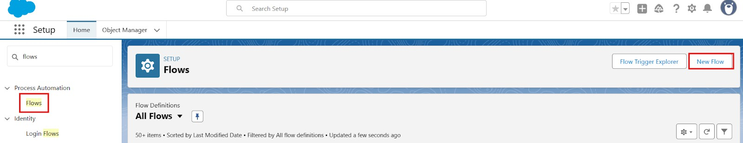
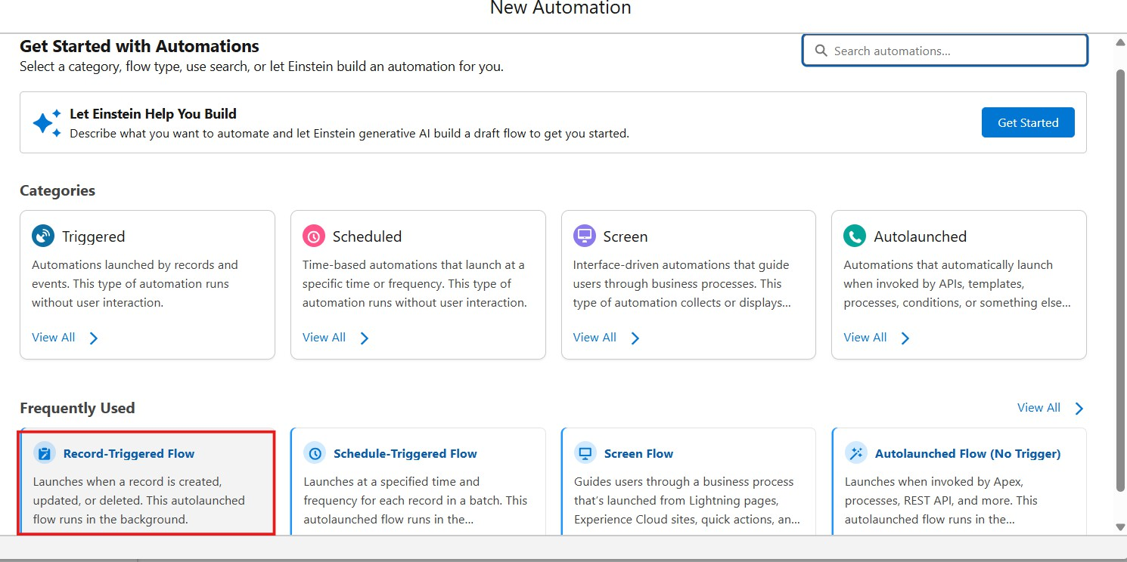
Step 1: Open Flow Builder
Click the Gear Icon → Click Setup
In the Quick Find box (left side), type Flows
Click Flows
Click the New Flow button
Select Record-Triggered Flow
Click Create
Step 2: Configure the Start (Trigger)

Slide 51
On the Start panel on the right:
Object: select Delivery_Update c
Trigger the Flow When:
  Select A record is created
Condition Requirements:
  Choose: None (Always Run the Flow)
Optimize the Flow For:
  Select Actions and Related Records
Click Done
Part 2: Update Related Shipment Record
Step 3: Add “Update Records” Element
Click the + icon under the Start element
Select Update Records
Configure the Update Records Element:
Label: Update_Shipment_Status
How to Find Records to Update:
  Select Specify conditions to identify records
Set Filter Conditions:
Object: Shipment c

Slide 52
Field: Id
Operator: Equals
Value: {!$Record.Shipment c}
(This means update the Shipment linked to the Delivery Update)
Set Field Values to Update
Add field mapping:
Shipment Field | Value Source
Status c | {!$Record.Status c}
(This copies status from Delivery Update to Shipment)
Click Done
Part 3: Save and Activate Step 4: Save Flow
Click Save (top-right)
Flow Label: Auto_Update_Shipment_Status
API Name will auto-fill
Click Save
Step 5: Activate Flow
Click Activate

Slide 53
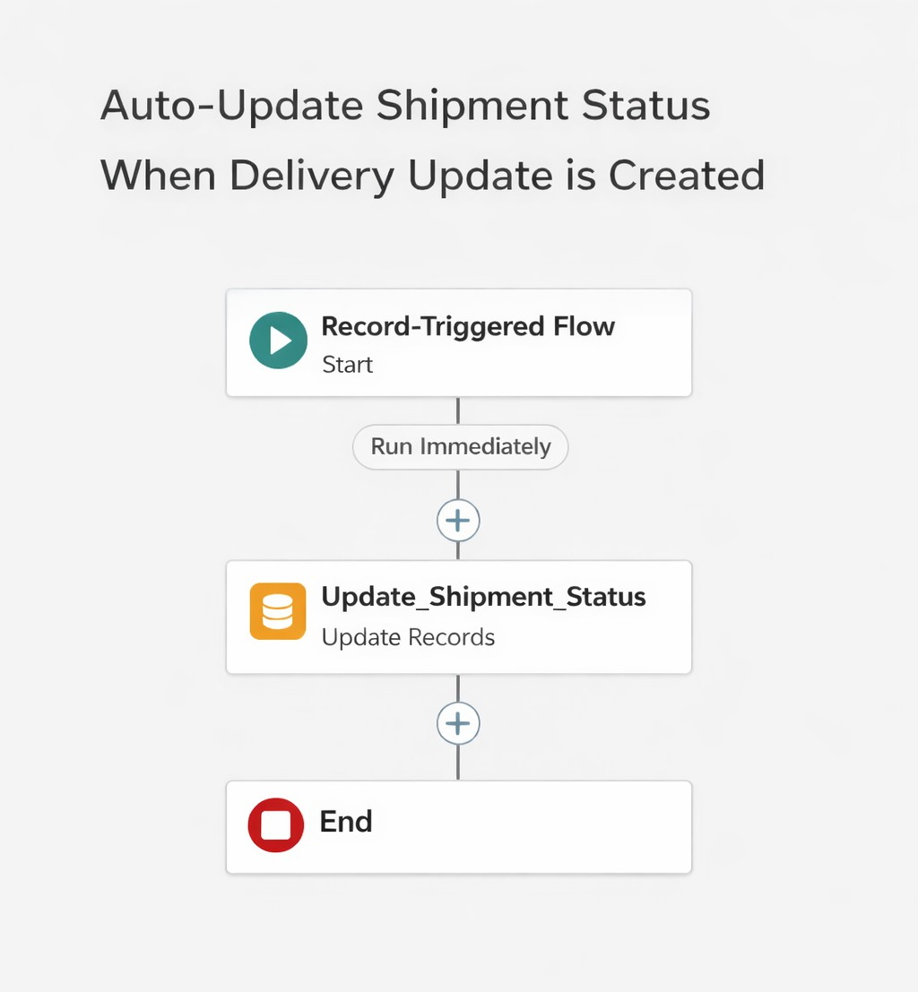
Flow status should show Active
Final Flow Layout:
Milestone 8 - The Lightning App :
What is an App ?
Apps in Salesforce are a group of tabs that help the application function by working together as a unit. It has a name, a logo, and a particular set of tabs. The simplest app usually has just two tabs.
Activity 1: Create a Lightning App
Create the Courier Management System App
1. From Setup, enter App Manager in the Quick Find and select App Manager.

Slide 54
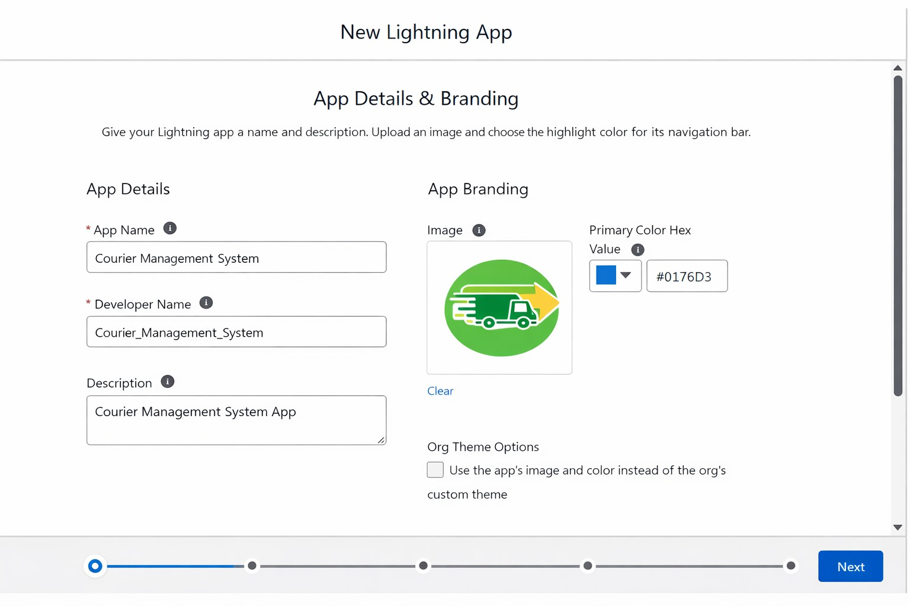
Click New Lightning App.
  Enter the Courier Management System as the App Name.
Upload an image or icon for the app, then click Next.
Under App Options, leave the default selections and click Next.
Under Utility Items, leave as it is and click Next.
From Available Items, select the following and move them to Selected Items:
  Customer
  Shipment
  Delivery Agent
  Branch
  Delivery Update

Slide 55
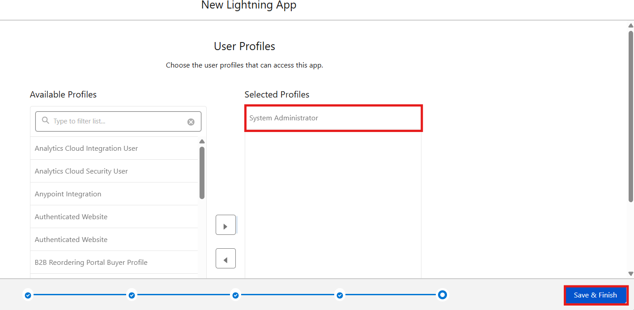
Invoice
Reports
Dashboards
Click Next.
From Available Profiles, select System Administrator and move it to Selected Profiles.
Click Save & Finish.
Milestone 9- Profile:
What is a profile?
A profile is a group/collection of settings and permissions that define what a user can do in salesforce. A profile controls “Object permissions, Field permissions, User permissions, Tab
settings, App settings, Apex class access, Visualforce page access, Page layouts, Record Types, Login hours & Login IP ranges.

Slide 56
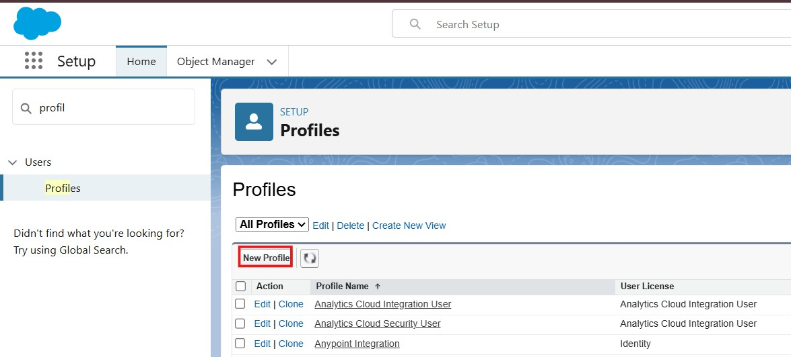
A profile can be assigned to many users, but users can be assigned a single profile at a time.
Activity 1: Create a Custom Profile – Courier Admin
Create a Custom Profile:
From Setup, enter Profiles in the Quick Find box.
Click Profiles.
Click New Profile.
Select Existing Profile as: System Administrator.
Enter Profile Name: Courier Admin.

Slide 57
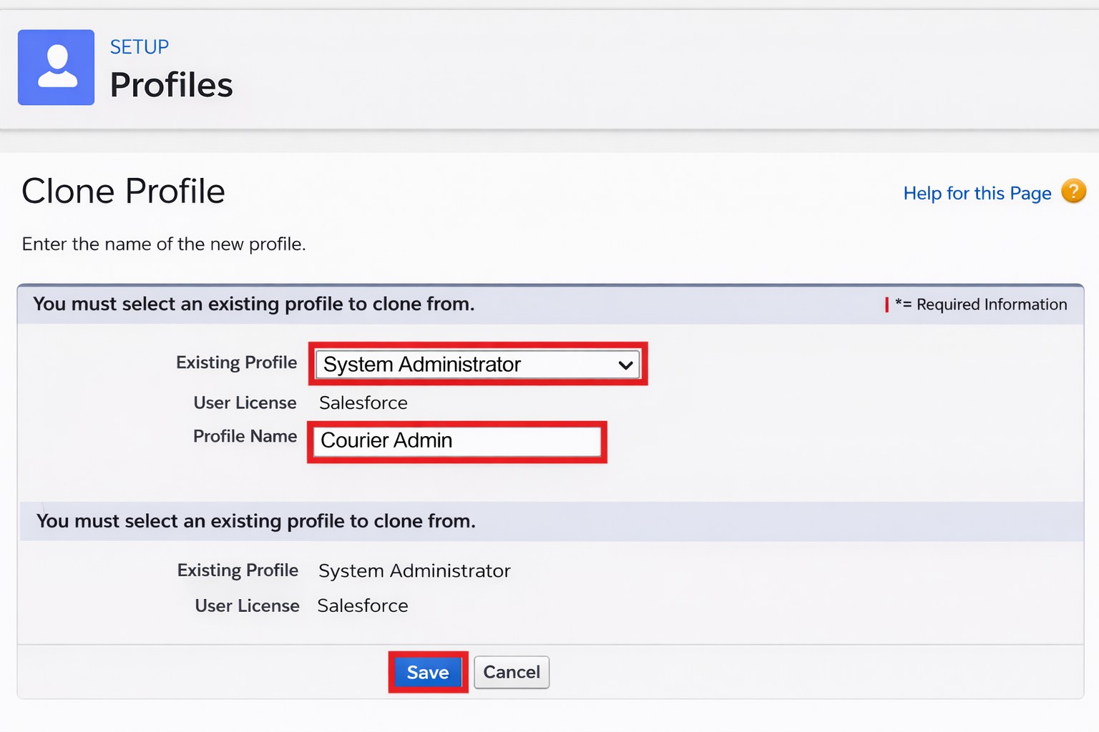
6. Click Save.
Why use System Administrator as Base?
It already has:
Modify All Data
Customize Application
Full CRUD access on all objects
By cloning it, the Courier Admin profile automatically inherits full access. You can later restrict permissions if required.
Activity 2: Create a Custom Profile – Branch Manager
Steps:
From Setup, enter Profiles in the Quick Find box.
Click Profiles.
Click New Profile.
Select Existing Profile as: Standard Platform User.

Slide 58
Enter Profile Name: Branch Manager.
Click Save.
Click Edit on the Branch Manager profile.
Set App & Tab Settings
Under Assigned Apps / Custom App Settings, set the default app to: Courier Management System App
Ensure Visible Tabs Include:
Set these tabs as Default On or Visible:
  Customers
  Shipments
  Delivery Agents
  Branches
  Delivery Updates
  Invoices
  Reports
  Dashboards
Custom Object Permissions
Scroll to Custom Object Permissions and set access as follows:
Object | Permissions to Grant
Customer c | Create, Read, Edit

Slide 59
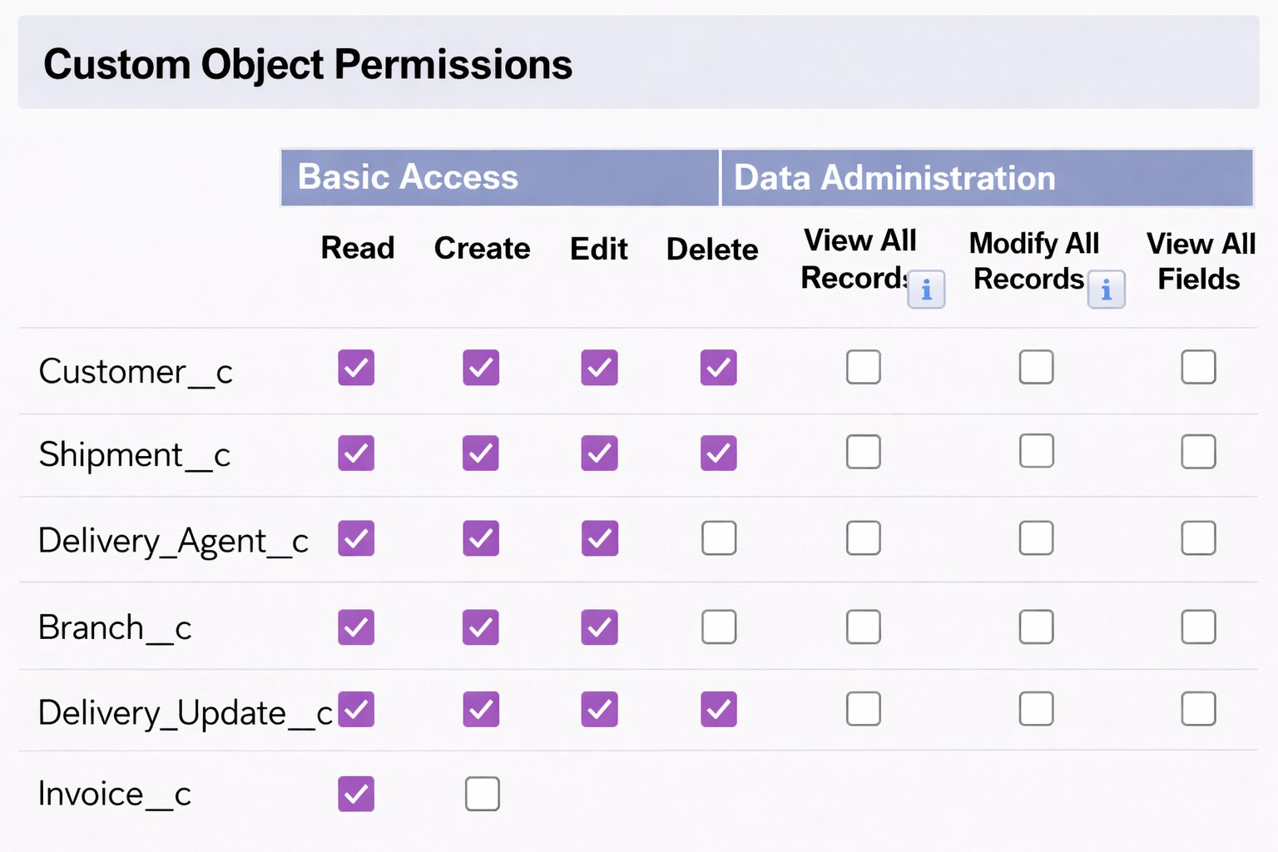
Shipment c | Create, Read, Edit
Delivery_Agent c | Read, Edit
Branch c | Read, Edit
Delivery_Update c | Create, Read, Edit
Invoice c | Read

Slide 60
Session & Password Settings
Under Session Settings:
Session Timeout: 2 Hours of Inactivity
Under Password Policies:
User passwords expire in: Never Expires
Minimum Password Length: 8
Click Save.
Activity 3: Create a Custom Profile – Delivery Agent
Steps:
Setup → Quick Find → Profiles
Click New Profile
Existing Profile: Standard Platform User
Profile Name: Delivery Agent
Click Save
App & Tab Access
Default App: Courier Management System Visible Tabs:
  Shipments
  Delivery Updates
Object Permissions :

Slide 61
Object | Permissions
Shipment c | Read, Edit
Delivery_Update c | Create, Read, Edit
Customer c | Read
Invoice c | Read
Restrictions
No access to Branch editing
No delete permissions
Limited reporting access
Click Save.
Activity 4: Create a Custom Profile – Customer Support
Steps:
Setup → Profiles → New Profile
Base Profile: Standard User
Profile Name: Customer Support
Access Configuration
Tabs Visible:

Slide 62
Customers
Shipments
Delivery Updates
Object Permissions :
Object | Access
Customer c | Read, Edit
Shipment c | Read, Edit
Delivery_Update c | Read
Invoice c | Read
Session Settings
Session Timeout: 2 Hours
Password Length: 8 Click Save
Final Profiles Created in Project :
Profile Name | Purpose

Slide 63
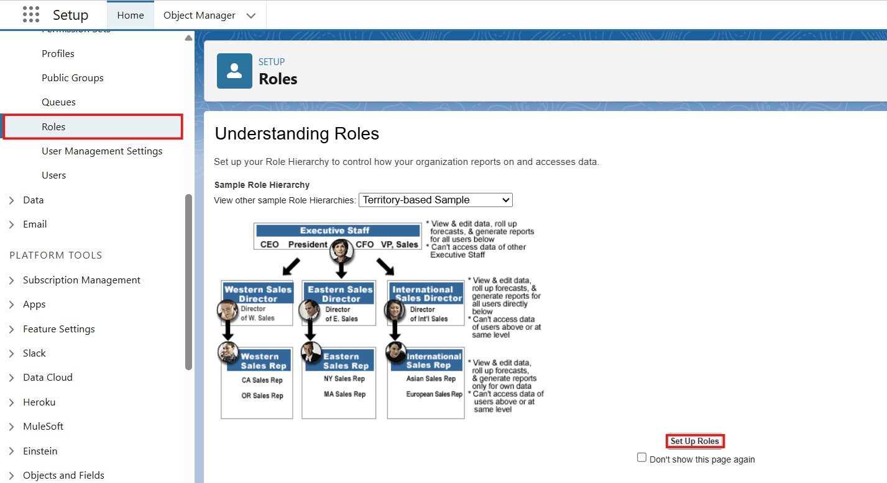
Courier Admin | Full system control
Branch Manager | Manage shipments and agents
Delivery Agent | Update delivery status
Customer Support | Handle customers and tracking
Milestone 10- Role:
In Salesforce, roles are used to determine which users have access to certain data and functions within the system. They are also used to define the reporting hierarchy within an organization. Users with higher roles have greater access to data and more control over the system.
Activity 1: Creation of Courier Admin Role
Creation of Role:
From the Quick Find box, search for Roles and click on the Roles option.
Select Set Up Roles.

Slide 64
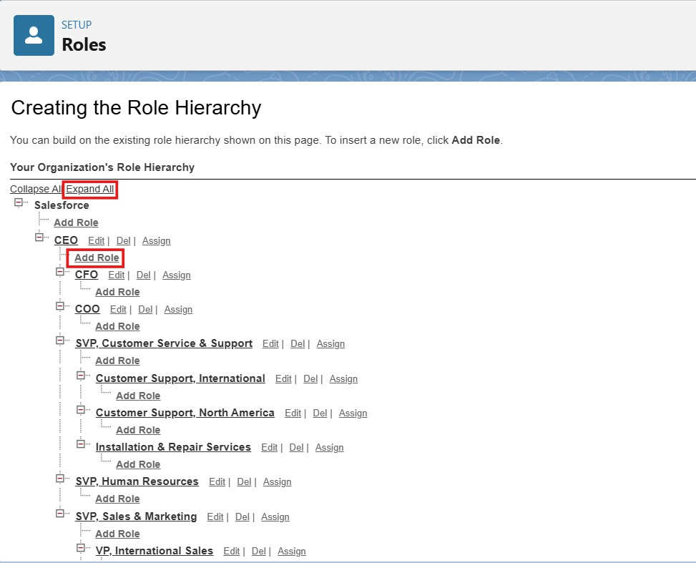
3. Click on Expand All and click Add Role under CEO.
Give Label as “Courier Admin”.
  The Role Name will auto-populate.
Click Save.
Activity 2: Creating Branch Manager Role Under Courier Admin Role
Create another role:
Create a role with the name “Branch Manager”.
Below the Courier Admin, click on Add Role.
Enter the label name as “Branch Manager” and the Role Name will automatically populate.

Slide 65
4. Click Save.
Activity 3: Creating Delivery Agent Role Under Branch Manager Role
Steps:
Below the Branch Manager role, click on Add Role.
Enter Label as “Delivery Agent”.
  Role Name will auto-populate.
Click Save.
Activity 4: Creating Customer Support Role Under Branch Manager
Steps:
Under the Branch Manager role, click on Add Role.
Enter Label as “Customer Support”.
Role Name will automatically populate.
Click Save.
Purpose of This Hierarchy :
  Courier Admin – Highest level access to all data
  Branch Manager – Manages branch-level operations
  Delivery Agent – Access only to assigned shipments
  Customer Support – Limited access to customer and shipment tracking
This hierarchy ensures proper data sharing and security in the Courier Management System.

Slide 66
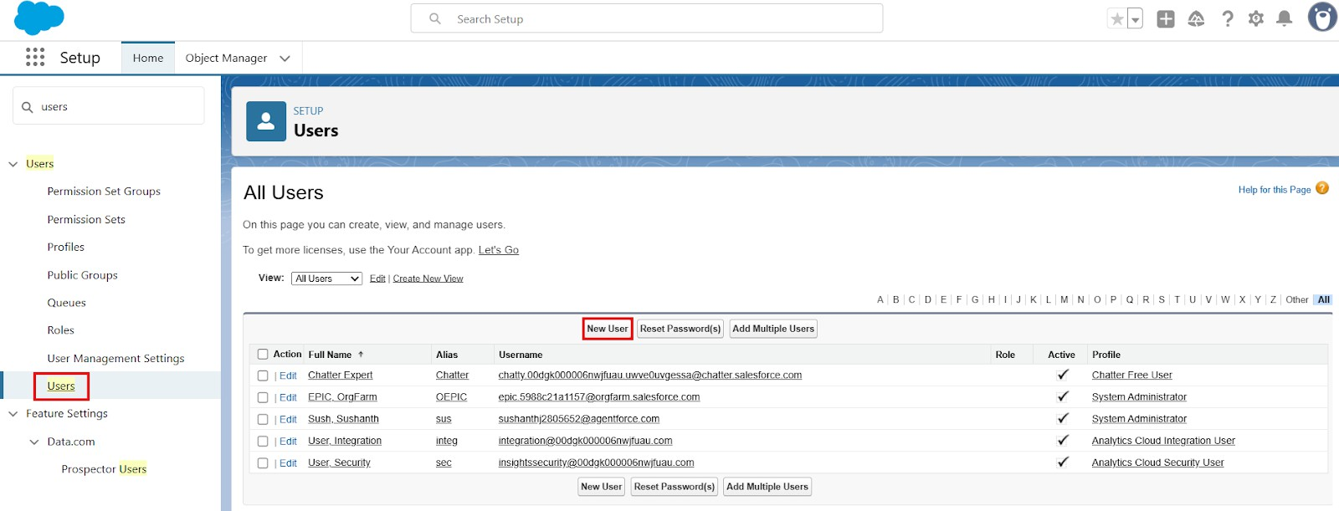
Milestone 11- User :
What is a user?
A user is anyone who logs in to Salesforce. Users are employees at your company, such as sales,reps, managers, and IT specialists, who need access to the company's records. Every user in Salesforce has a user account. The user account identifies the user, and the user account settings determine what features and records the user can access.
NOTE- As Salesforce license can only be used by 2 Users at a time in Dev Org, So If you don’t find a salesforce license then deactivate a user who has a salesforce license Or change the license type from Salesforce to any other.
Activity 1: To Create a User
Steps:
From Setup, enter Users in the Quick Find box, then select Users.
Click New User.
Fill in the Fields:
Field Name | Value
First Name | Enter first name (Example: Ravi)
Last Name | Enter last name (Example: Kumar)

Slide 67
Alias | Give an alias name
Email ID | Enter your personal email ID
Username | Must be in the format: text@text.text and must be unique
Nickname | Give a nickname
Role | Select Courier Admin
User License | Salesforce
Profile | Courier Admin
3. Click Save.
Activity 2: Creating Other Users
Repeat the same steps as Activity 1 for creating additional users. Use the following details:
User Type | Role | User License | Profile
Branch Manager | Branch Manager | Salesforce | Branch Manager
Delivery Agent | Delivery Agent | Salesforce Platform | Delivery Agent
Customer Support | Customer Support | Salesforce Platform | Customer Support
Example:
To create a Branch Manager User:
Go to Setup → Users → New User
Fill details like:

Slide 68
Field | Example Value
First Name | Arjun
Last Name | Reddy
Email | arjun@gmail.com
Username | arjun.manager@cms.com
Role | Branch Manager
Profile | Branch Manager
Click Save
\
To Create Delivery Agent User:
Follow same steps with:
Role: Delivery Agent
Profile: Delivery Agent
To Create Customer Support User:
Role: Customer Support
Profile: Customer Support
Important Points
Every user must have:
  Unique username
  Valid email
  Assigned Role

Slide 69
Assigned Profile
Profiles control permissions
Roles control data visibility
Milestone 15 : Reports & Dashboards
Reports and Dashboards help analyze business data and track courier operations efficiently.
Activity 1: Create Report Types
Step 1: Open Report Types
Click Gear Icon → Select Setup.
In Quick Find search Report Types.
Click New Custom Report Type.
Step 2: Create Shipment Report Type
  Primary Object: Shipment c
  Label: Shipment Tracking Report
  Category: Reports
  Deployment Status: Deployed
  Click Next → Save
Step 3: Create Customer Report Type
  Primary Object: Customer c
  Label: Customer Summary Report
  Category: Reports

Slide 70
Deployment Status: Deployed
Click Next → Save
Step 4: Create Agent Performance Report Type
Primary Object: Delivery_Agent c
Label: Agent Performance Report
Category: Reports
Deployment Status: Deployed
Click Next → Save
Activity 2: Create Reports
Report 1: Shipment Status Summary Report Step 1: Create the Report
Click App Launcher (9 dots) → Search Reports
Click New Report
Choose Shipment Tracking Report
Click Continue Step 2: Add Columns Add these fields:
  Tracking Number
  Customer
  Status

Slide 71
Expected Date
Assigned Agent
Step 3: Add Filters
Show Me: All Shipments
Date Filter: This Month
Status Filter: Select specific Status (Optional)
Step 4: Group & Summarize
Group rows by Status c
Add summary on Price
Step 5: Save Report
Click Save & Run
Name: Shipment Status Summary
Folder: CMS Reports
Report 2: Agent Performance Report
Step 1: Create Report
New Report → Choose Agent Performance Report
Click Continue
Step 2: Add Columns
Agent Name
Branch

Slide 72
Number of Shipments
Status
Step 3: Group Data
Group by Delivery_Agent c
Step 4: Save Report
Name: Agent Performance Report
Folder: CMS Reports
Save & Run
Report 3: Revenue Report Steps
Create report using Shipment Tracking Report Type
Add fields:
Tracking Number
Customer
Price
Invoice Status
Group by:
Branch
Month
Save as: Revenue by Branch Report

Slide 73
Activity 3: Create Dashboard
Step 1: Open Dashboards
Click App Launcher (9 dots)
Search Dashboards
Click New Dashboard
Step 2: Enter Dashboard Details
  Name: Courier Management Dashboard
  Folder: CMS Reports
  Click Create
Activity 4: Add Dashboard Components
Component 1: Shipment Status Overview (Donut Chart)
Click + Component
Choose report: Shipment Status Summary
Visual Type: Donut Chart
Click Add
Component 2: Agent Performance (Bar Chart)
  Select report: Agent Performance Report

Slide 74
Chart Type: Bar Chart
Click Add
Component 3: Revenue by Branch (Column Chart)
Choose report: Revenue by Branch Report
Chart Type: Column Chart
Click Add
Activity 5: Save & Activate Dashboard
Click Save
Click Done
Share Dashboard With:
  Courier Admin
  Branch Managers
  Customer Support Team

Slide 75
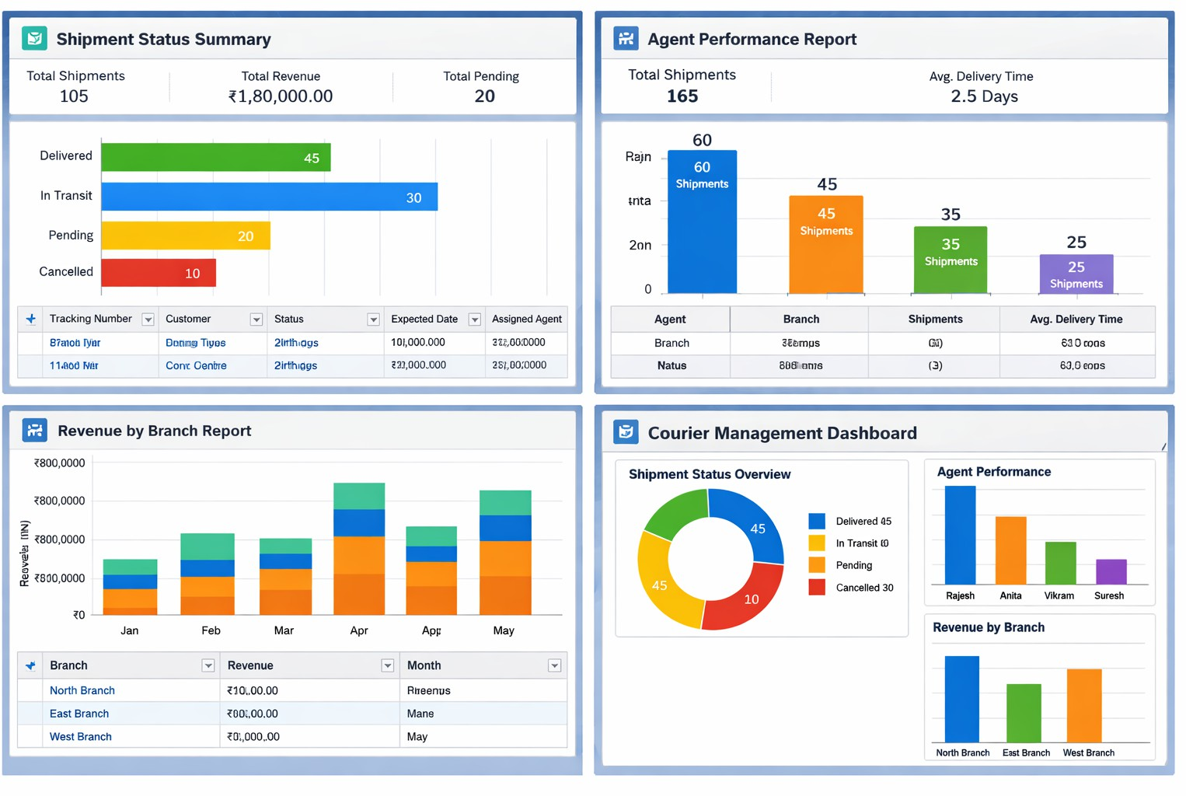
Final Layout :
FUNCTIONAL & PERFORMANCE TESTING
During testing, screenshots were captured from Salesforce to verify record creation, validation rule enforcement, delivery status updates, flow automation, invoice generation, and dashboard visualization. All scenarios were validated to ensure correct performance and reliability.
ADVANTAGES & DISADVANTAGES

Slide 76
Advantages
Centralized data
Automated workflows
Real-time reporting
Disadvantages
Salesforce dependency
Requires initial configuration effort
Conclusion:
The Courier Management System successfully digitizes courier operations using Salesforce automation, improving efficiency, accuracy, and customer satisfaction.
FUTURE SCOPE
  Mobile tracking app
  GPS integration
  SMS notifications
  AI-based delivery optimization
APPENDIX
  Source Code: Salesforce Configuration
  Dataset: Salesforce Objects
  GitHub / Demo: Salesforce Developer Org

Slide 77
Thank You

